Slide 1

IBM HR Analytics Employee Attrition & performance (EDA Project)
Hussain Al-Sultan

Slide 2
Overview
There are many factors that affect employee’s decision. Data scientists at IBM created a fictional data to uncover the most relevant factors that lead to employee attrition.
The fictional data included factors such as education level, job involvement, job satisfaction, performance rating, relationship satisfaction and work life balance. The data contains 1470 entries and data 35 columns.
The questions that will be examined are:
Q1) What is the most impacted field of education by attrition?
Q2) What is the consequence of last promotion on the number of attritions?
Q3) What is the relationship between the age and attrition?
Q4) What is the relationship between gender and attrition?
Q5) How job role in the company effect attrition?
Q6) How distance from home effect attrition?

Slide 3

Work Progress
Step 1
Data Exploring and cleaning
Step 2
Fix and remove any noisy rows
This Photo by Unknown Author is licensed under CC BY-SA
Step 3
Step 4
Answering the questions
Problem solution and recommendation
PHASE 5
Find top/bottom five stations

Slide 4
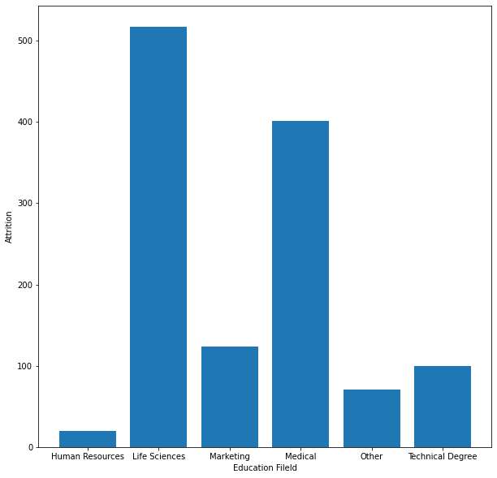
Q1)What is the most impacted field of education by attrition?

Slide 5
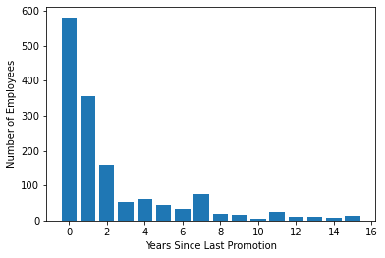
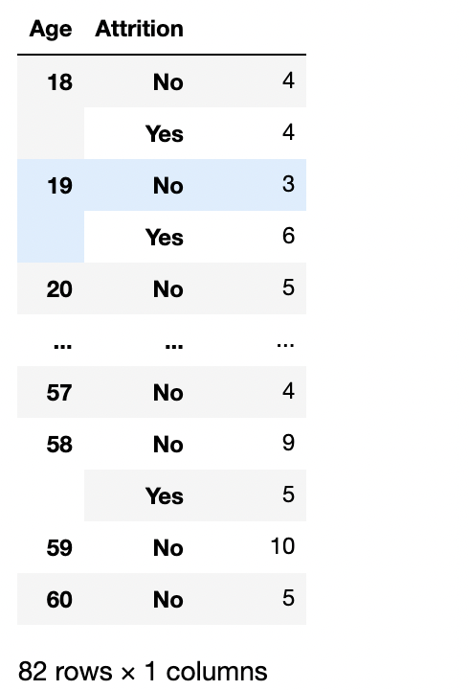
Q2) What is the consequence of last promotion on the number of attritions?
Q3)What is the relationship between the age and attrition?

Slide 6
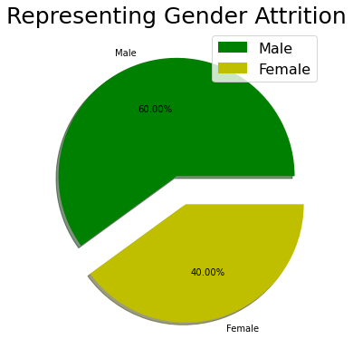
Q4) What is the relationship between gender and attrition?

Slide 7
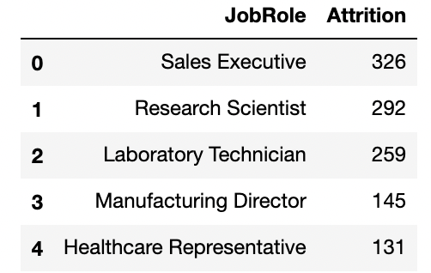
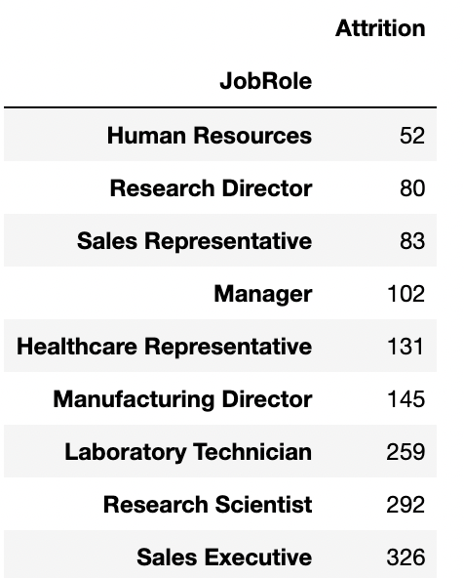
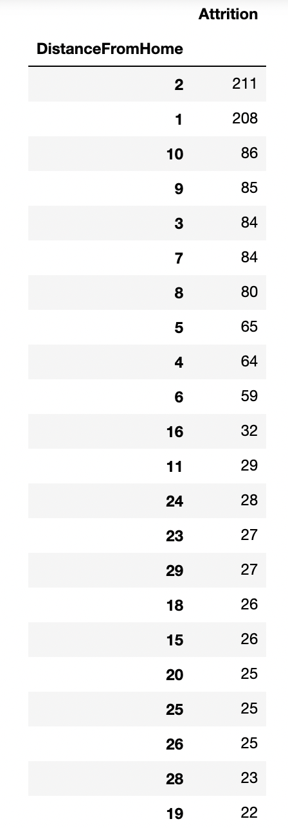
Q5) How job role in the company effect attrition?
Q6) How distance from home effect attrition?

Slide 8
Solution and Recommendation
Providing the IBM HR with accurate analysis of the most relevant variables which have a direct effect on the number employees leaving
Using the tools and libraries that we have learned in previous weeks
Jupyter (Python, Pandas, NumPy, Matplotlib, Seaborn)

Slide 9

Conclusion
This Photo by Unknown Author is licensed under CC BY-SA

